Slide 1

Mentoring FIRST Teams
TEAM 2080

Slide 2
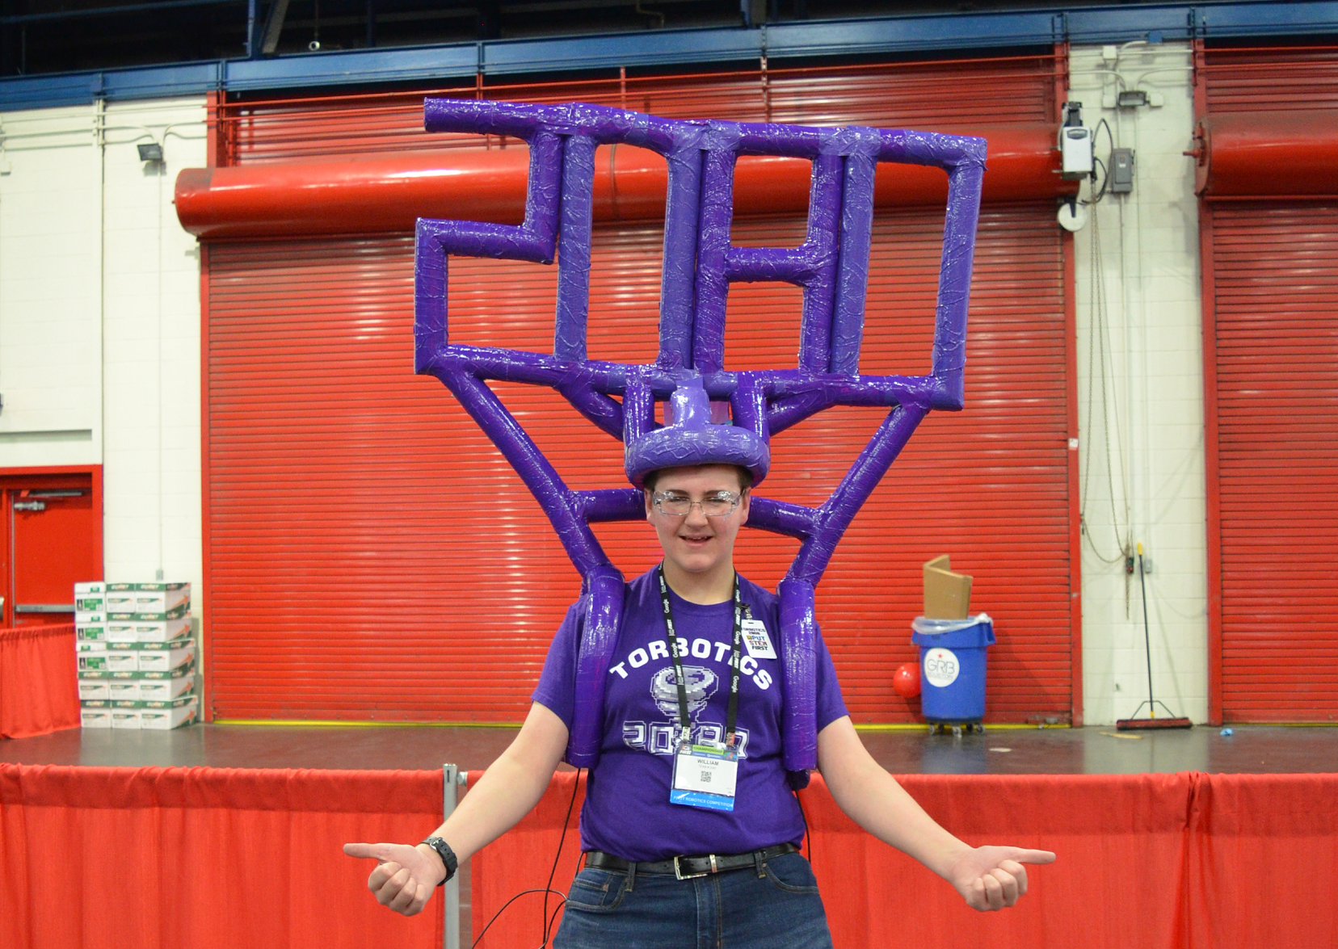
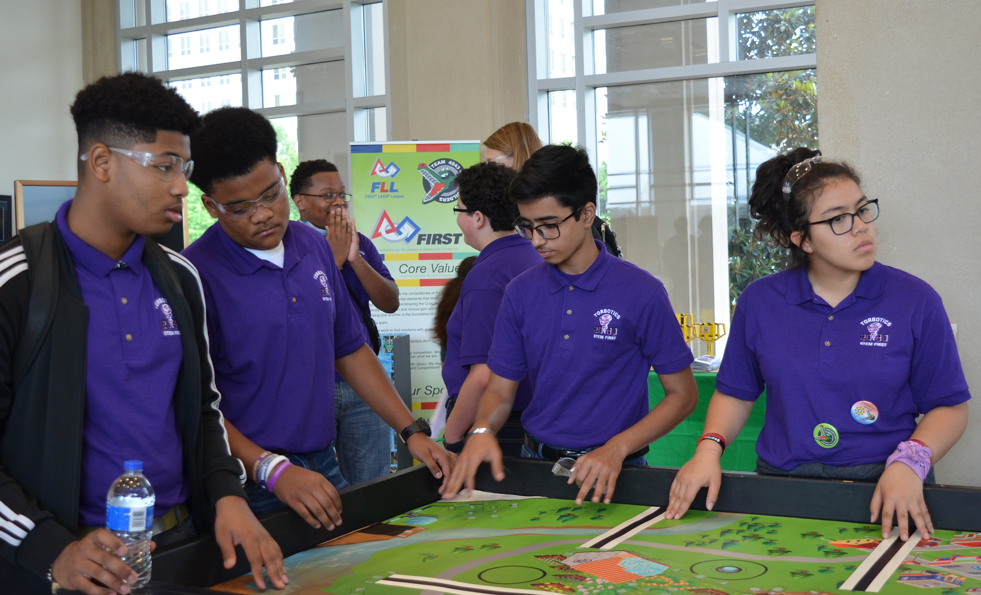
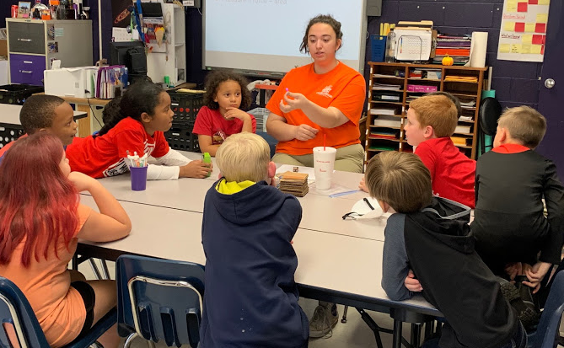
#BuildingBetterTogether
It’s the mission of FIRST!
There is so much to gain from mentoring other FIRST teams.
It can help you gain a whole different perspective.
You can change someone’s world and strengthen the lessons you have already learned.
You can learn so much from the experiences of others, while also increasing your own confidence in your abilities.
You can further develop more effective communication skills.
If you want to effect long lasting change within your community toward more value placed on STEM, there is no better way than to become a mentor.

Slide 3
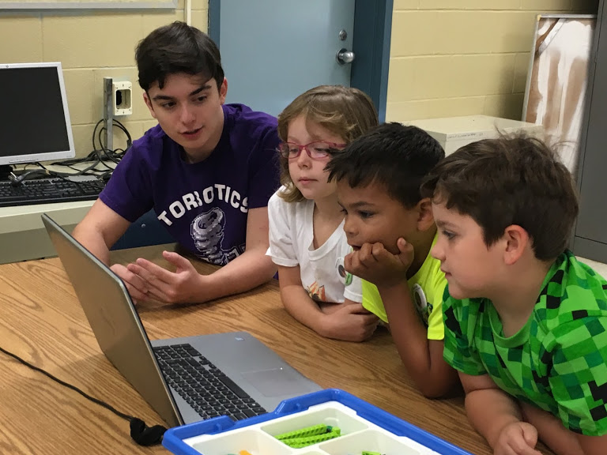
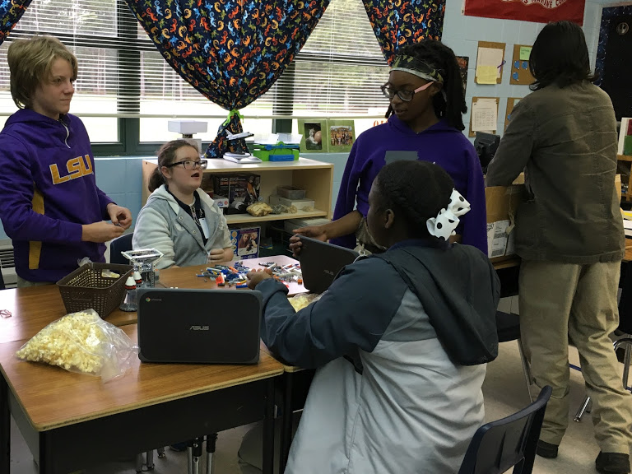
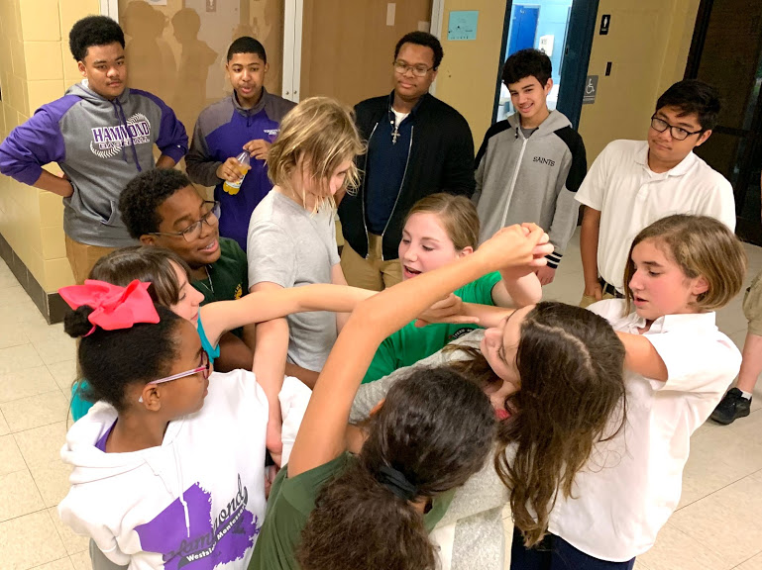
#BuildingBetterTogether
How does FIRST define mentorship?
FIRST has a very specific definition in mind when it comes to what it means to mentor a team.
“A Team has Mentored a team if they have met all of the following requirements:
Provided consistent (at least once a week during the lead up to competitions) communication, either in person or via phone/email/video conference, to the Mentored team helping with technical or non-technical FIRST program specific issues.
The Mentored Team agrees that the Mentoring team did in fact Mentor them (and will put that in writing).

Slide 4
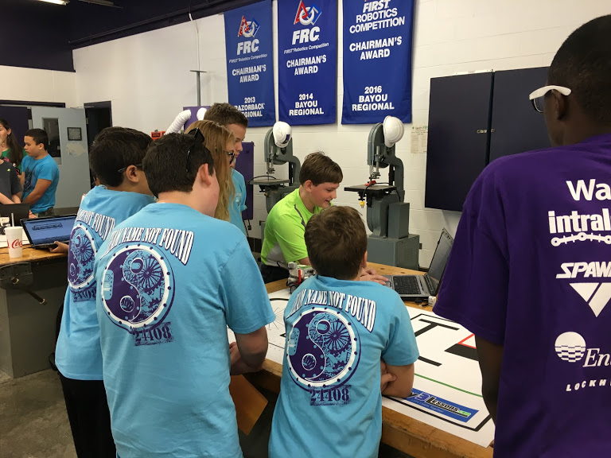
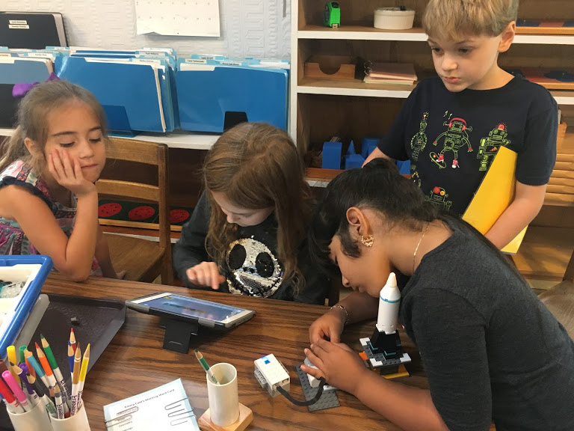
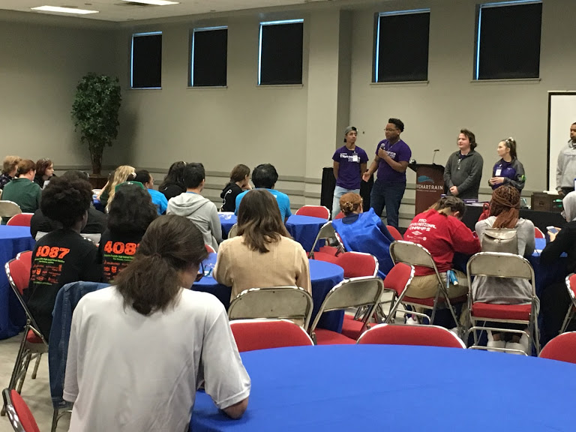
#BuildingBetterTogether
How do we get started?
Reach out to local teams near you and ask if they need assistance.
Let teams know how you can assist them.
If transportation is an issue, remember you can always set up video calls & emails.
Start with programs where you feel comfortable.
DON’T FORGET
The best way to help sustain FIRST programs in your area is by supporting & starting other FIRST teams.
Some of your most rewarding experiences in FIRST can come from mentoring other teams.

Slide 5
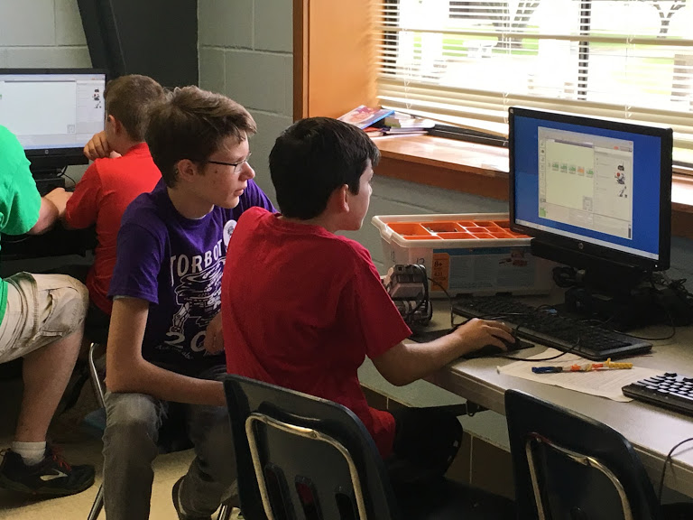
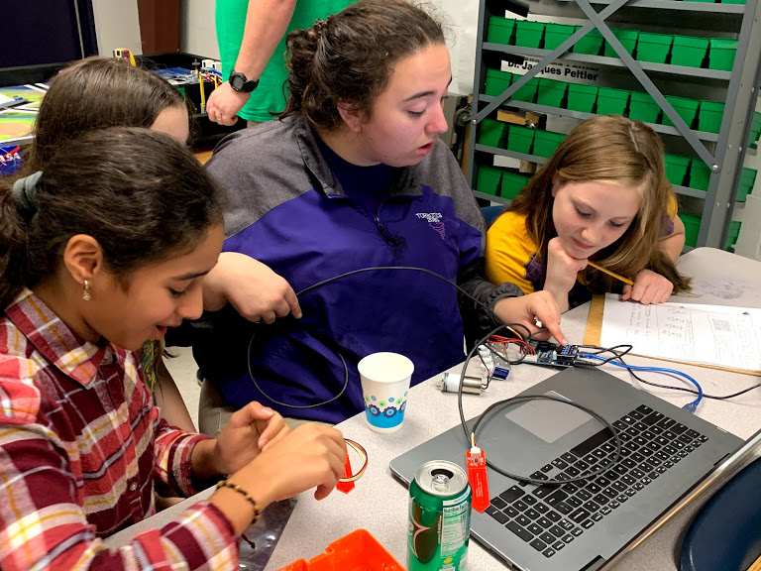
What are teams expecting from a mentor?
They want you to share your knowledge & experiences.
When they encounter a problem, they want your help to talk through it as they develop their solution.
They want your help to give them the tools they need not only to build a robot but to formulate & develop a better team.
They want you to help them have fun & spark their continued inspiration.
Remember, you're not telling them what to do. Instead, you’re assisting in developing their plan.

Slide 6
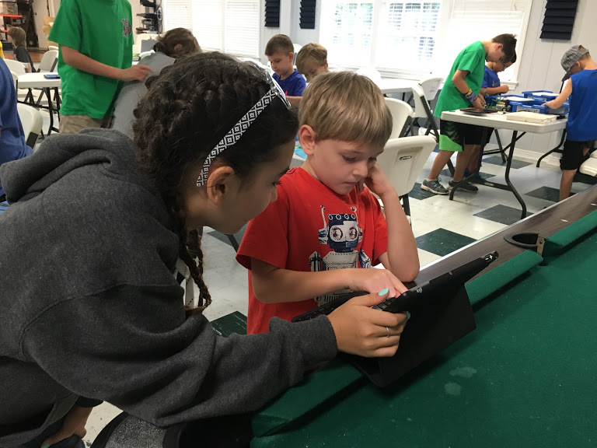
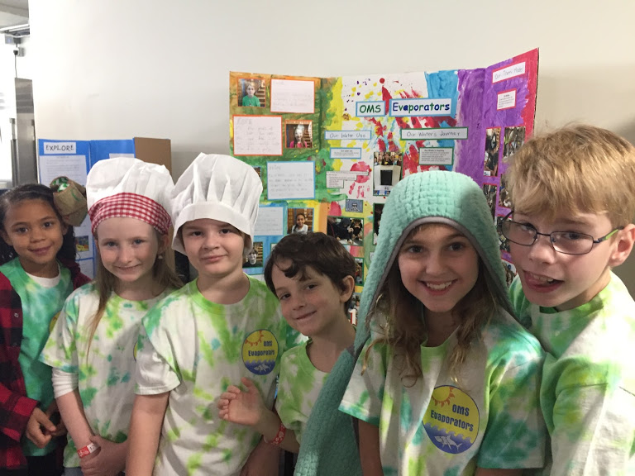
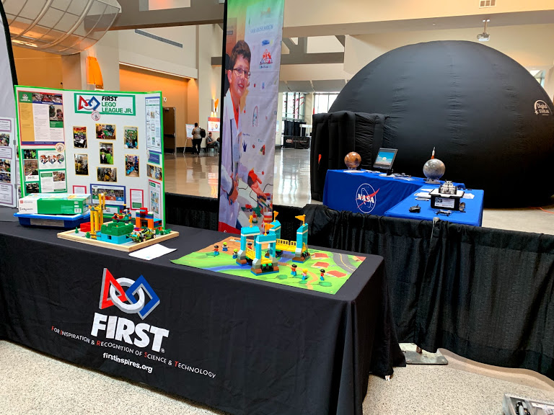
Tips for Mentoring FLL Discovery
(K-1st grade)
Your main goal when mentoring an FLL Discovery team is to help students connect with the materials & promote spontaneous discovery.
You are there to support what students are learning & serve as a role model.
TIPS
For this group, you are there to facilitate. You’re most often directing & encouraging student inquiry & asking open ended questions.
You get to inspire & help build confidence.
You are foremost building curiosity, not a robot, & not a solution.

Slide 7
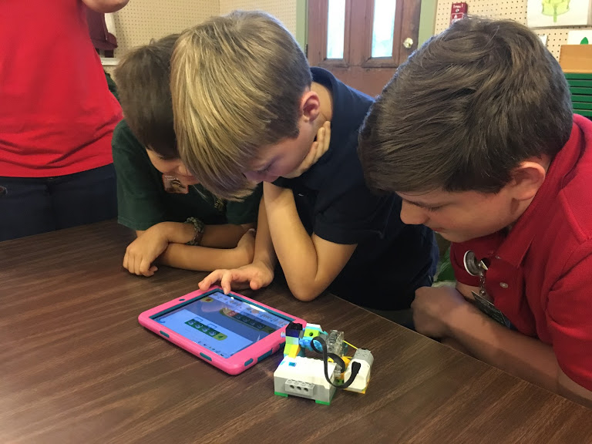
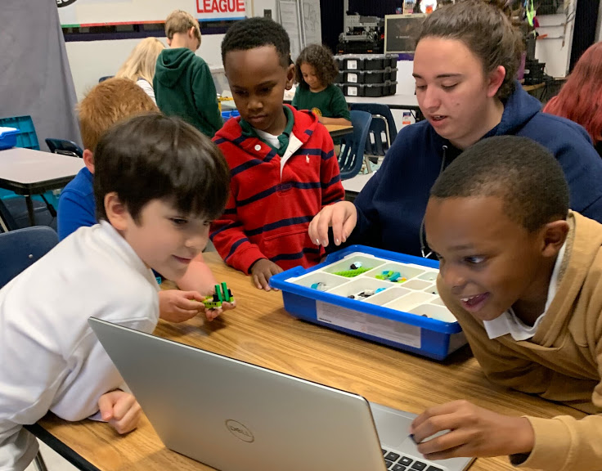
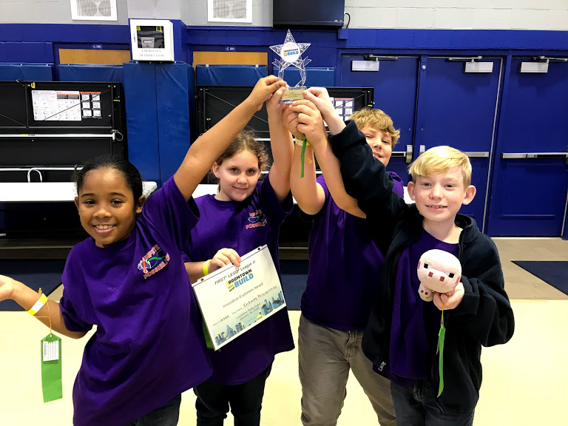
Tips for Mentoring FLL Explore
(2nd - 4th grades)
Your main focus with FLL Explore is to assist & support students in the development of their model & Show Me poster.
You are there to show them basic build techniques & support them through the process of designing/building a mechanical component to their models.
TIPS
Let your team fail, & give them a chance to learn from their mistakes. To FAIL is just a First Attempt In Learning.
These are younger students. Be sure to set age appropriate expectations.
Not everything will be perfect. Sometimes when you prepare an interesting experiment the students won’t be interested, and that’s ok.

Slide 8
Tips for Mentoring FLL Challenge
(4th - 8th grades)
These students should seek independence.
Look for ways to encourage talking things out with the whole team. You can get some discussion going & watch them develop their ideas instead.
Introduce them to the engineering design process.
The way kids learn best is through experimentation of their ideas & seeing what works & doesn’t work.
Team discussions are a great way to start & end meetings. Help them brainstorm & prioritize what needs to get done & followed up.
TIPS
Have fun & encourage fun. What we discover is more important than what we win, & if we have fun during the discovery, we will remember it better!
It is OKAY to not have all the answers! Model how to research & successfully work with others.

Slide 9
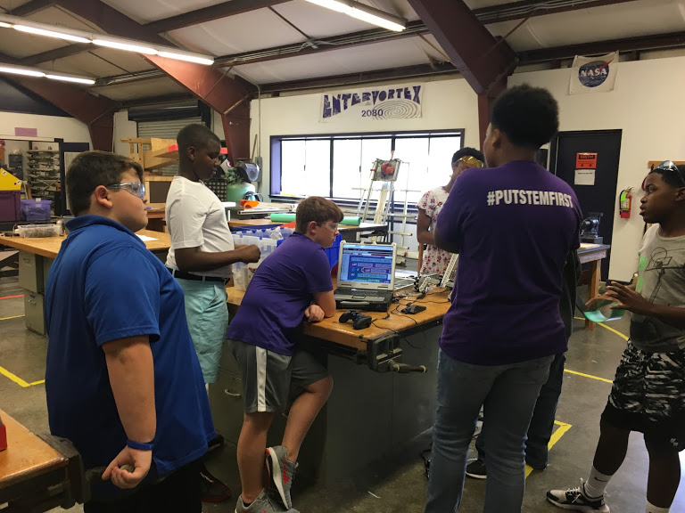
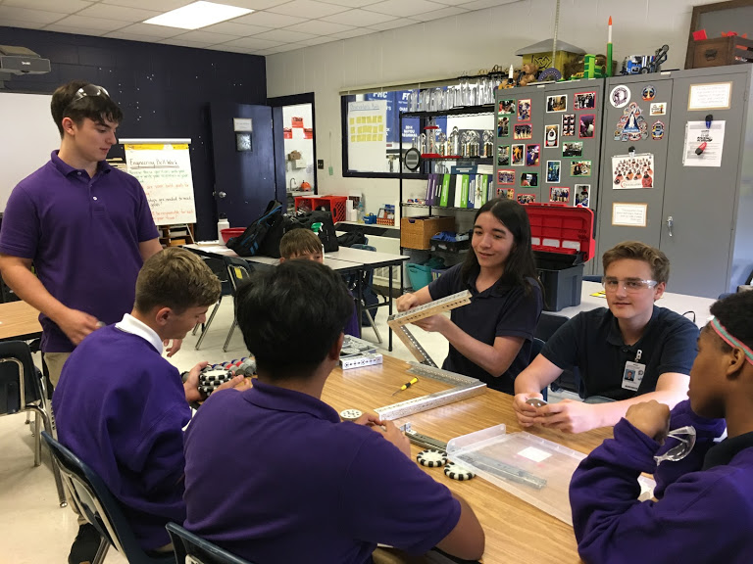
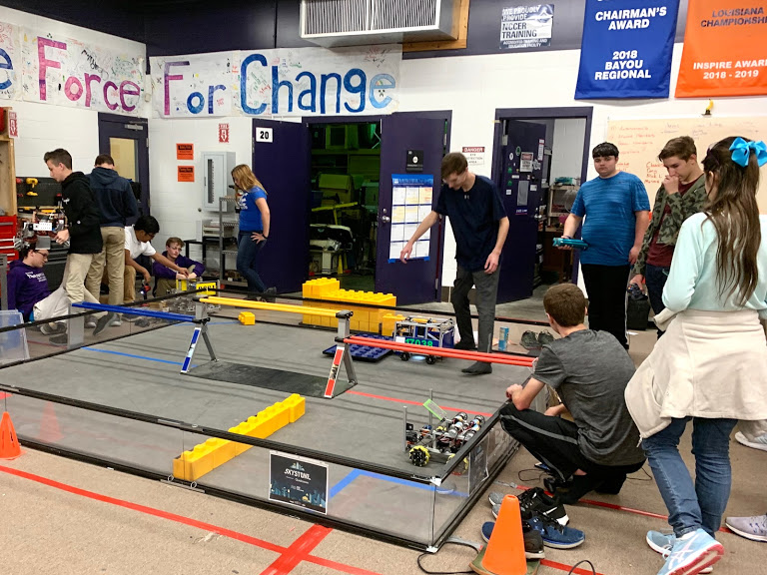
Tips for Mentoring FTC Teams
(7th - 12th grades)
A big piece of mentoring an FTC team is helping them gain an understanding of the different components & the potential for everything to come together.
Cost & time constraints are now a big factor. Providing teams with tips to run productive meetings & ensuring good documentation is key. Be prepared to model this, if needed.
TIPS
Make sure everyone’s ideas are heard & some time is spent thinking them through.
Definitely stress the importance of reading through & really understanding the game release manual. Robot design should coincide with game strategy.

Slide 10
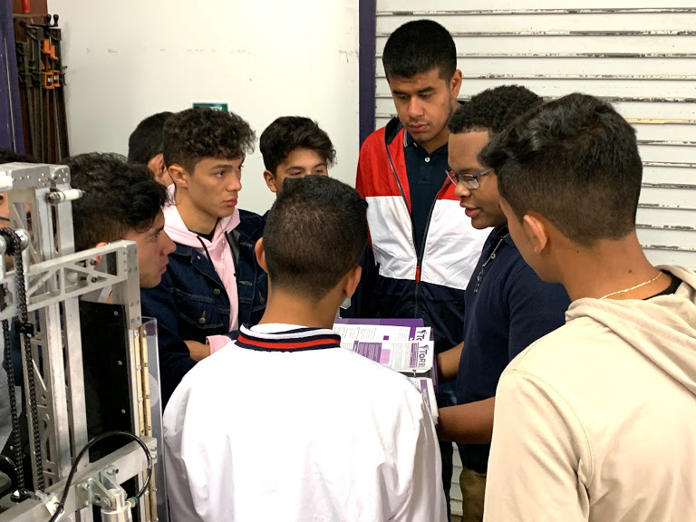
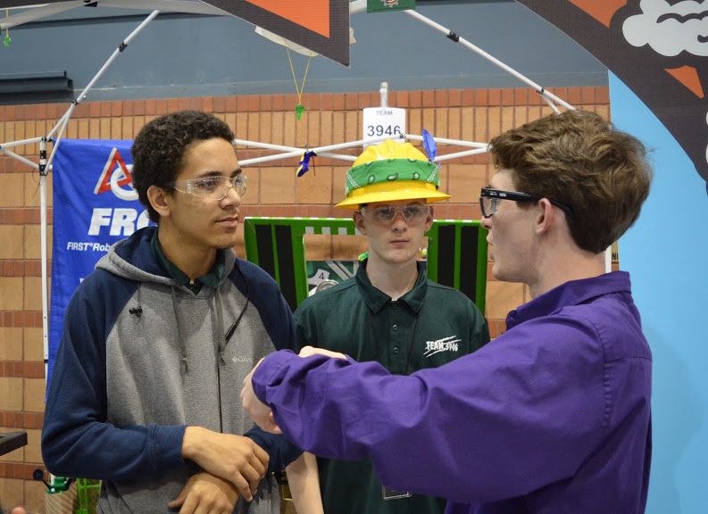
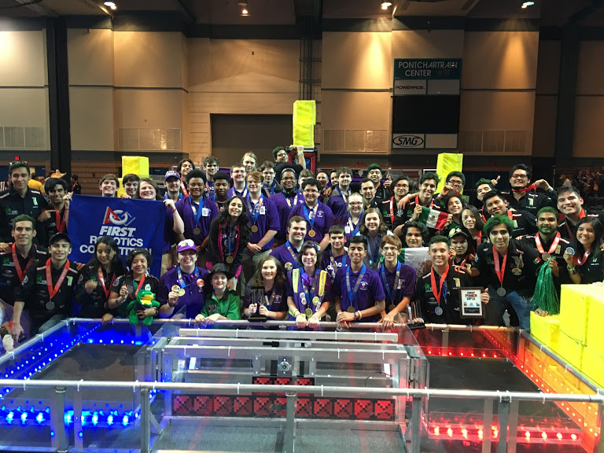
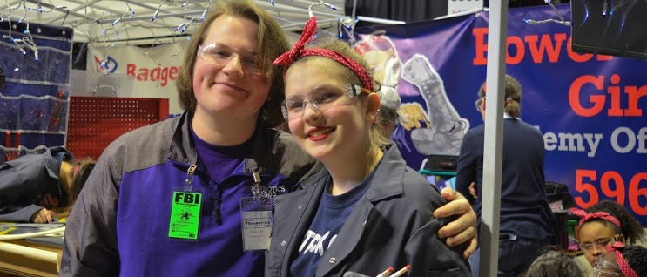
Tips for Mentoring FRC Teams
(9th - 12th grades)
As a student member, this can feel like a hard division to mentor because we’re all learning within the same program at the same time.
Remember, teams helping other teams is at the heart of gracious professionalism.
From the moment you really start to learn in FRC, your goal should be to make sure others gain from this experience.
TIPS
The best way we’ve found to mentor FRC is through developing strong connections with others & being there to regularly answer questions while looking for ways to learn together.

Slide 11
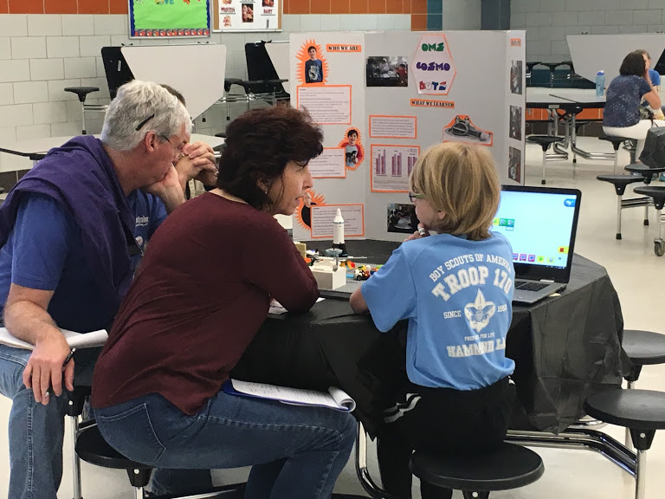
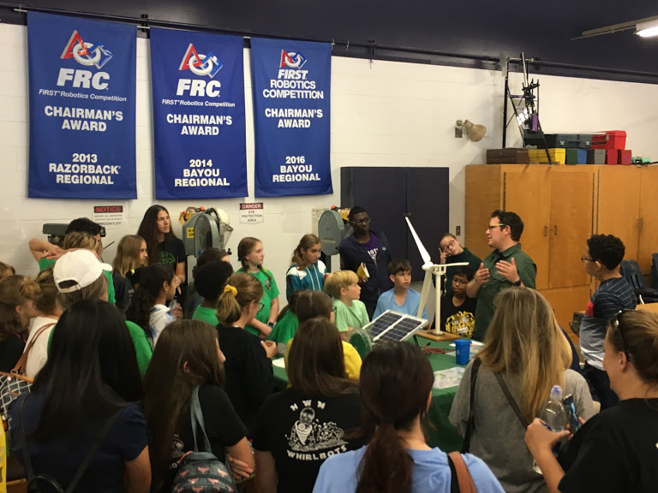
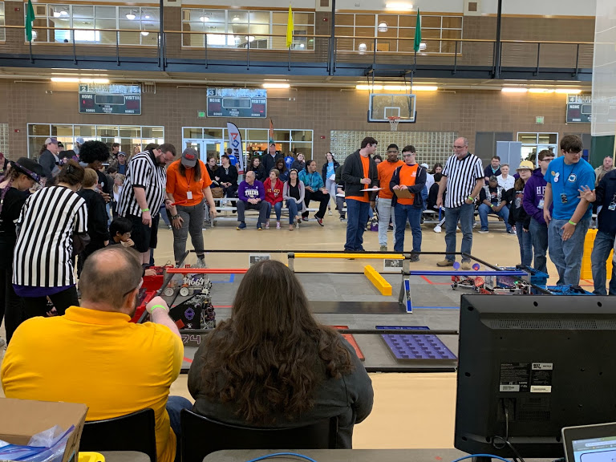
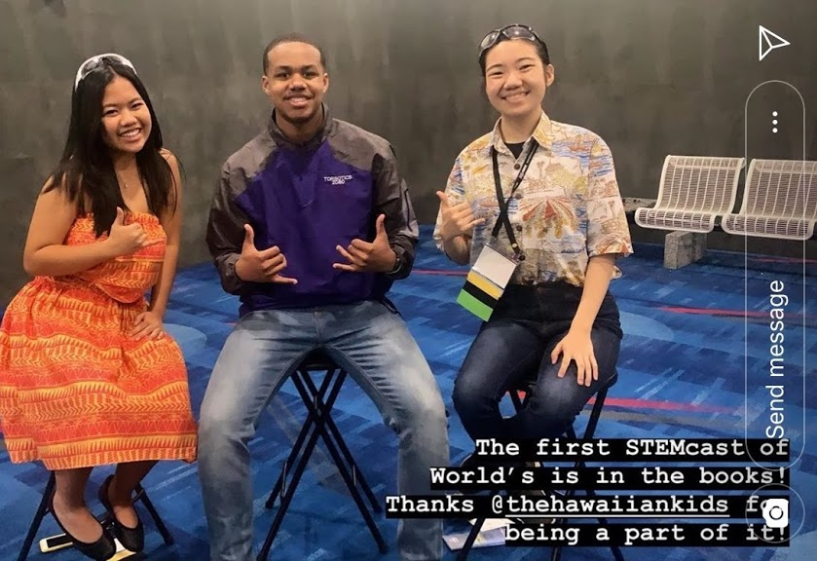
Other Ways to Support FIRST Teams
Plan break out sessions at regional fast starts or at competitions; focus on getting teams to share successes, ask questions & foster relationships.
Ex: Tips for documentation, what & how does your team document progress?
If you have a large shop or work place, allow other teams to share it.
Publish materials on your website, youtube, or social media that can help teams in all divisions.
Host or facilitate regional qualifiers for FLL & FTC.
Volunteer to assist other programs in running their state or regional championships.
Host or facilitate off-season events, including open invitationals, & season jump starts.
You are only limited by your imagination.

Slide 12

Credits
This lesson was written by FRC 2080 for FRCTutorials.com
You can contact the author at frcteam2080@gmail.com or www.torbotics2080.org
More lessons for FIRST Robotics Competition are available at www.FRCtutorials.com
This work is licensed under a
Creative Commons Attribution-NonCommercial-ShareAlike 4.0 International License.

